Slide 1
Quantum Information Processing with Closed Timelike Curves
Todd A. Brun (USC)
Collaborators: Jim Harrington, Mark M. Wilde, Andreas Winter

Slide 2
Closed timelike curves
Closed timelike curves (CTCs) are spacetime objects allowed by the theory of general relativity (although perhaps not by a complete theory of quantum gravity).
Recent work has shown how CTC resources would greatly boost classical and quantum computational power.
Question: how are information processing tasks affected when a party has access to (localized) CTCs?

Slide 3
Time-travel paradoxes
The possibility of time travel has always raised difficult questions about causality. These are often phrased in terms of paradoxes, that fall into two main types:
Grandfather paradoxes. A time traveler goes back before his father was born and kills his grandfather. Therefore, he was never born, and never went back.
Uncaused effects. A time traveler receives a piece of information from her future self; in the future, she passes in back to her earlier self. Where did the information come from?

Slide 4
Solving hard problems with CTCs
Grandfather paradoxes seem difficult to accommodate within a reasonable theory (though Deutsch makes a good try, as we shall see). But the kind of self-consistent evolution described in the second paradox might actually be exploited.
Suppose we set up a situation in which an inconsistency will occur unless some specified information appears. We could then find the answers to hard problems without going to the trouble of actually solving them.

Slide 5
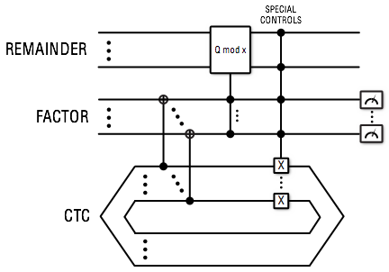
Factoring numbers
Brun, Found. Phys. Lett. 16, 245 (2003).
Here we find a solution by threatening to produce a paradox if the solution does not appear. In fact, far more powerful computations are generally possible. To show this, though, one needs a more precise model of how CTCs work.

Slide 6
Deutsch’s self-consistency criteria
D. Deutsch, Phys. Rev. D 44, 3197 (1991)
V
time
CTC
system

Slide 7
Solving problems with DCTCs
Bacon, PRA 70, 032309 (2004); Aaronson and Watrous, Proc. R. Soc. A 465, 631 (2009)
Since DCTCs produce an effective nonlinear evolution, they can (for example) magnify the probability of distinguishing one quantum state from another, nonorthogonal, state.
Bacon showed that this could be used to solve NP-complete problems—in particular, the problem SAT. A nonlinear evolution allows him to distinguish between 0 and >0 satisfying assignments for a Boolean function.

Slide 8
The Complexity Zoo
PSPACE
PP
NP-Complete
NP
BQP
P
EXP

Slide 9
Aaronson and Watrous carried this a step further, showing that both classical and quantum computers with CTCs could efficiently solve any problem in PSPACE.
They used the property of the Deutsch approach that it finds a self-consistent solution for . They set up the program so that the only self-consistent evolution is a loop over all configurations of a Turing machine, with a control bit b set to the final answer to the problem. Note that this differs from the structure above.
DCTCs can also enhance other tasks.

Slide 10
Distinguishing Arbitrary States
U_{k}
time
SWAP
CTC
system
We can perfectly distinguish an arbitrary set of (in general nonorthogonal) states using DCTCs: .
This will break any QKD protocol that relies on nonorthogonality; it also allows a single q-bit to carry an arbitrary amount of information.
Brun, Harrington and Wilde, PRL 102, 210402 (2009).

Slide 11
Infinite channel capacity
To make a single quantum bit carry n bits of information, choose 2^{n} nonorthogonal states:
Alice encodes her n-bit message by selecting one of these states and sending it to Bob. Using a DCTC, he can determine which state was sent and extract n bits of information, where in principle n is arbitrarily large.

Slide 12
Arbitrarily Good Cloning
Brun, Wilde and Winter, arXiv:1306.1795.
The ability to distinguish an arbitrary set of states suggests that DCTCs might also be able to clone any given state to arbitrary accuracy.
This doesn’t follow immediately—in the distinguishability protocol, the set of states was known ahead of time. In cloning, the state is arbitrary.

Slide 13
A natural approach to try would be to choose a set such as an ε-net of states and run the distinguishability protocol for this set. One would then make some kind of locality or continuity argument that initial states not in the net should be measured with high probability as a nearby state.
Working out simple examples seems to bear this out, but it has been difficult to prove that it works in generality. Instead, we have produced a cloning procedure with a different structure.

Slide 14
Meeting yourself in a bar
The trick is to use the fact that a DCTC allows you to create many temporary perfect clones of a system.
The unitary that does this is a cyclic shift.
If one could extract information from these clones before they disappear, without disrupting the cyclic shift solution, would would have a cloner.

Slide 15
It turns out that if the state is diagonal in a known basis, we can do this:
We can think of this as cloning a classical probability distribution.
If it is not, we can project it into a diagonal state in a given basis, and then clone the resulting distribution.
But to clone an arbitrary state requires measuring in different bases. Trying to do this disrupts the cyclic shift solution.

Slide 16
The trick is to first carry out the steps of a generalized measurement:
After this step, the state is diagonal in a known basis, and can therefore be cloned by the previous argument.
By choosing the POVM elements to be informationally complete we can clone arbitrary states.

Slide 17
The DCTC Cloner
Putting this all together gives us our cloner:

Slide 18
DCTCs and Many-Worlds
Suppose that Alice and Bob are in the following superposition state:
Since Deutsch justifies his criterion within the Many-Worlds interpretation of QM, this is a natural state to arise. But note, here the protocol fails!
It seems that to use the Deutsch criterion, one must know the state of the full wavefunction, not just your own “branch.”

Slide 19
Discussion
The CTC in these constructions need only exist a very short time (just long enough for the unitaries); for state discrimination, they are needed only on Bob’s side.
In the absence of noise, an arbitrary number of classical bits can then be stored and retrieved with a single qubit (either by state discrimination or by cloning), thus violating Holevo’s bound of one bit per qubit.
This system also raises uncomfortable questions about superluminal signaling.
It is also not entirely clear how it works within the Many-Worlds theory used to justify it.

Slide 20
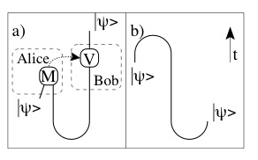
Postselected CTCs
Lloyd et al., PRL 106, 040403 (2011); Lloyd et al., arXiv:1007.2615v1.
A different approach to describing QM with CTCs was invented (but never published) by Bennett and Schumacher.
This approach is based on teleportation. If one were guaranteed to always get a particular desired measurement outcome, one could teleport a copy of a state into the past. This type of CTC can therefore be simulated by QM with postselection.

Slide 21
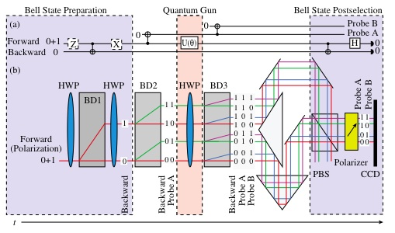
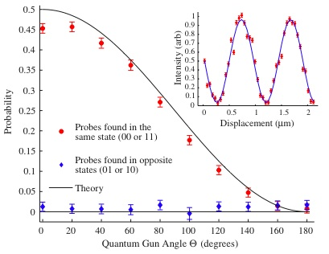
A time-travel experiment!?
A PCTC protocol was simulated (by post-selection) in the lab of Aephraim Steinberg.
The experiment showed that in this approach, Grandfather paradoxes are forbidden.

Slide 22
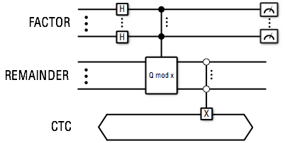
Computational Power of PCTCs
Brun and Wilde, Found. Phys. 42, 341 (2012).
PCTCs also enable efficient algorithms for hard problems. Here is a circuit for factoring:
Note that this requires only a single qubit to be sent back in the CTC.

Slide 23
Complexity Alphabet Soup
In fact, it is not difficult to show that quantum computers with PCTCs are as powerful as quantum computers with postselection: they can solve any problem in the complexity class PP.
The most widely believed inclusions for computational complexity classes are:
If this is true, the PCTCs are more powerful than standard QCs, but less than DCTCs.

Slide 24
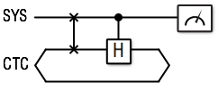
Distinguishing Nonorthogonal States
PCTCs also allow us to distinguish nonorthogonal states. (In fact, the same circuit works as with DCTCs.)
However, PCTCs can only distinguish sets of states that are linearly independent. So they don’t violate the Holevo bound.

Slide 25
Cloning?
Since PCTCs do not allow one to distinguish arbitrary sets of states, it is clear that arbitrarily good cloning is also impossible.
It seems very likely that PCTCs would allow better imperfect cloning than standard QM. But we have not worked out the size of the improvement, if any.

Slide 26
Are PCTCs paradox-free?
Unlike DCTCs, PCTCs do not have solutions for every situation. Inconsistent evolutions—grandfather paradoxes—do not admit solutions.
This gives another way of understanding the information-processing power of PCTCs. By setting up two alternatives—one paradoxical, the other one not—the probability of the second alternative can be dramatically enhanced.
However, paradoxes of the second type—in which information seemingly appears out of nowhere—are still allowed by PCTCs. In fact, the structure of algorithms for PCTCs very much follows the model of “threatening paradoxes” if information does not appear.

Slide 27
Other Approaches to CTCs
Politzer, Phys. Rev. D 49, 3981 (1994); Hartle, Phys. Rev. D 49, 6543 (1994).
A number of other approaches have been suggested for QM with CTCs.
In the 1990s, both H. David Politzer and James Hartle did calculations for quantum evolutions on spacetimes with CTCs. While the results are not exactly comparable, the are somewhat similar in flavor to PCTCs.
Tim Ralph has suggested a Heisenberg-like approach to CTCs, which he has argued leads to DCTC-like behavior.
T.C.Ralph, Phys. Rev. A 76, 012336 (2007).

Slide 28
Conclusions
DCTCs have advantages, in terms of guaranteed solutions and straightforward interpretation. But it is not clear that they can really be fit into a Many-Worlds picture, as claimed, and they are disturbingly powerful.
PCTCs may make connection to other approaches (e.g., that of Hartle), and avoid some of the paradoxes of DCTCs without having to invoke Many Worlds. But they still lead to strange evolutions, and in some ways have broader effects than DCTCs.

Slide 29
Of course, we have no evidence that CTCs exist at all! And if they do, this becomes at least partially an experimental question.
But playing around with these systems is a lot of fun, and raises interesting logical questions about causality and information that may have applications elsewhere. And it certainly beats working for a living.

